Slide 1

THE ZONES OF REGULATION®

Slide 2

AIMS:
Overview of self-regulation
To understand how ‘The Zones of Regulation’ works
Self-regulation tools
  Calming techniques
  Thinking strategies
  Sensory supports

Slide 3
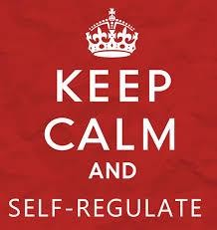
DEFINITION OF SELF-REGULATION:
“…it is defined as the capacity to manage one’s thoughts, feelings and actions in adaptive and
flexible ways across a range of contexts.”
Jude Nicholas
It encompasses:
Self-control
Resilience
Self-management
Anger management
Impulse control
Sensory regulation

Slide 4

WHY IS SELF-REGULATION IMPORTANT?
Life is 10% what happens to us and 90% how we react to it.
Charles Swindoll
Research has found that higher academic achievement is more likely when interventions include self-regulation components.
Typically, children who can self-regulate will turn
into teens who can self-regulate.

Slide 5


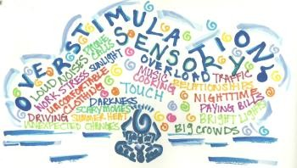
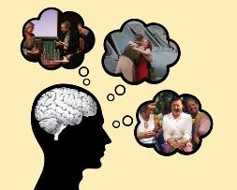
A person who can self-regulate is able to:
remain CALM AND ORANISED in a stressful situation.
(Executive Functions)
cheer themselves up after a disappointment.
(Emotional Regulation)
knows when they are experiencing sensory overload and can make adjustments.
(Sensory processing)
Understands when it is appropriate to cheer and shout and when to be quiet.
(Social cognition)

Slide 6
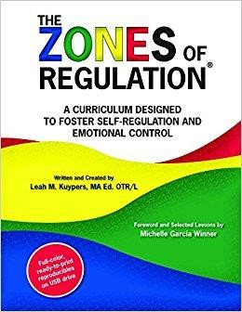
WHAT ARE THE ZONES OF REGULATION®?
Teaches students:
Vocabulary of emotional terms
How to recognise their own emotions
How to detect the emotions of others (read others’ facial expressions)
What may trigger certain emotions
How others may interpret their behaviour
Problem solving skills

Slide 7
WHY TEACH THE ZONES OF REGULATION®?
Provides a common language to discuss emotions – a language that is non-judgemental.
The Zones of Regulation is simple for children to understand but is helpful for all!
The Zones teach healthy coping and regulation strategies.
>>> Clear progression across the curriculum (overview and home learning).

Slide 8
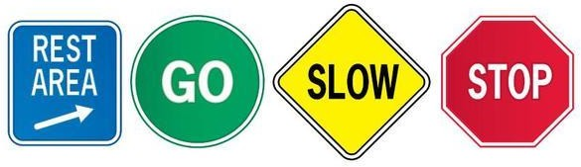
Blue Zone: sad, sick, tired or bored (low state of alertness – brain and/or body is moving slowly or sluggishly).
Green Zone: in control, calm, happy and ready to learn
(regulated state of alertness).
Yellow Zone: more intense emotions and states but able to maintain control, worried, frustrated, silly, excited, scared or overwhelmed (heightened state of alertness but you still have some control).
Red Zone: elated, angry, wild, terrified. (heightened state of
alertness and out of control).

Slide 9
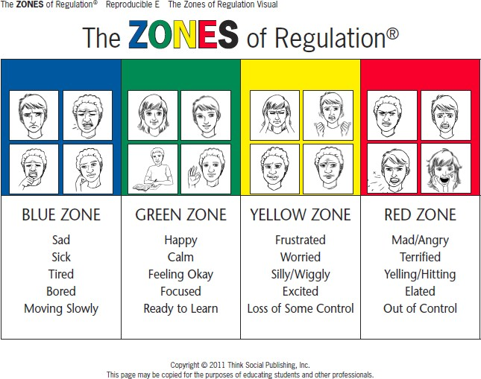

Slide 10
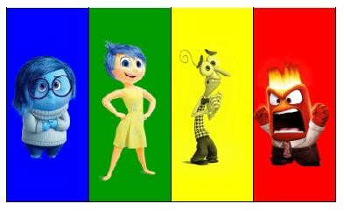
OTHER ZONES VISUALS

Slide 11
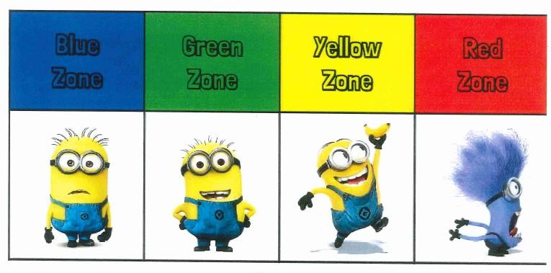
OTHER ZONES VISUALS

Slide 12
KEY POINTS:
There is no ‘bad’ Zone.
Everyone experiences all of the Zones at different times and in different circumstances.
We can’t change the way children feel BUT we can help them manage their feelings/states and behaviours. “It’s OK to be angry but it is not OK to hit…”
You can be in more than one Zone at a time (eg. sad AND angry).

Slide 13
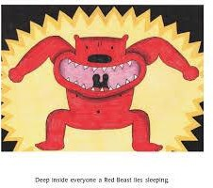
KEY POINTS:
If your child is confidently using words to describe their emotions, they don’t need to revert to Zones language HOWEVER it is useful for them to know the strategy groups that will help them.
Eg. sick or tired = blue zone strategies
If your child is in the Red Zone…
Limit verbals – this is not a teachable moment.
Discuss use of tools when child is regulated.
Plan for if/when child is in Red Zone.“Wonder if this strategy would help…?”

Slide 14
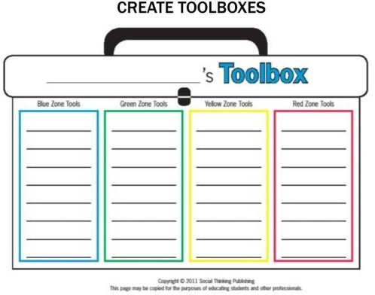
UNDERSTANDING ZONE TOOLS:
Blue Zone tools: help wake up our bodies, feel better and regain focus.
Green Zone tools: help us stay calm, focused and feeling good.
These are often proactive strategies.
Yellow Zone tools: help us regain control and calm ourselves. Red Zone tools: help us stay safe and start to calm down.
Pick 2/3 for each Zone (depends on child).

Slide 15
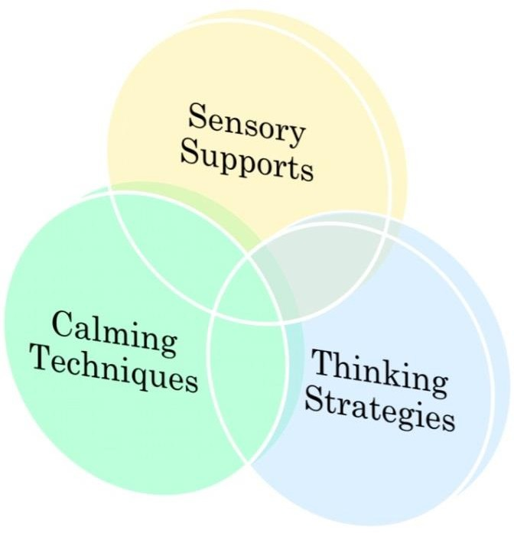
TOOLS FOR SELF-REGULATION

Slide 16
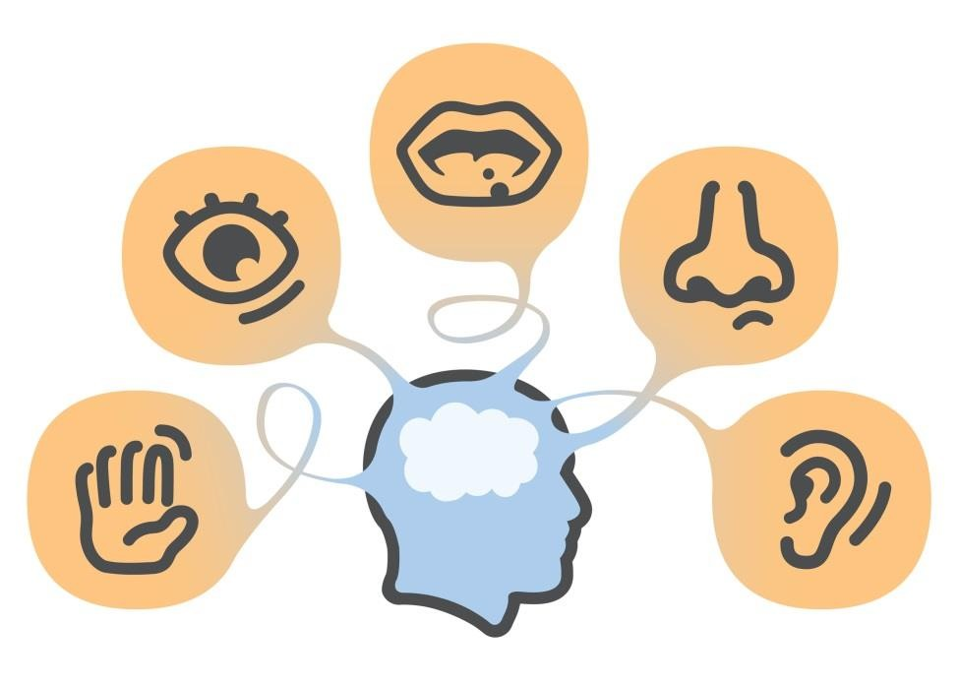

Slide 17



SENSORY STRATEGIES:
Bear Hug
Swing/rock
Go for a walk
Wall push ups
Sucking smoothie through straw
Chewy foods (eg. thick slice of bread)
Blow bubbles
Classical music
Roll on an exercise ball
Trampoline
Blanket roll
THESE ARE NOT A TREAT BUT A TOOL TO HELP THE CHILDREN FEEL REGULATED.
Which sensory supports do you use in daily life?

Slide 18

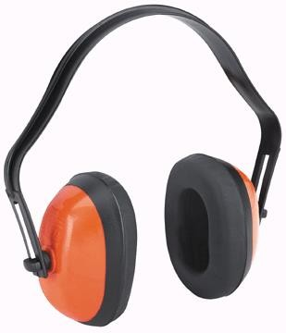
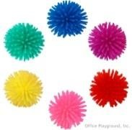


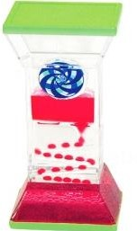
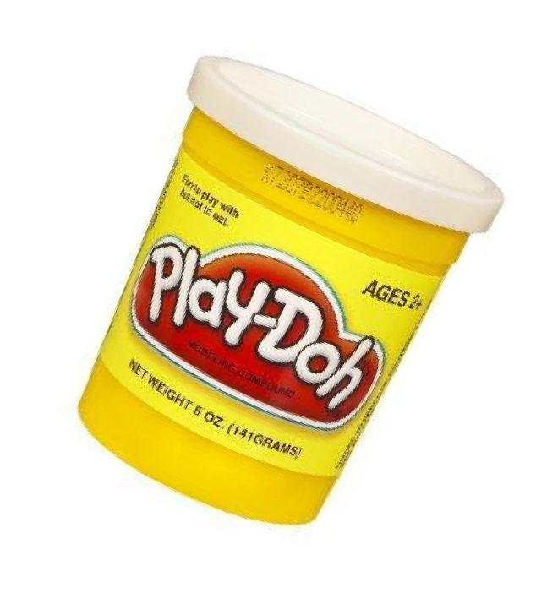

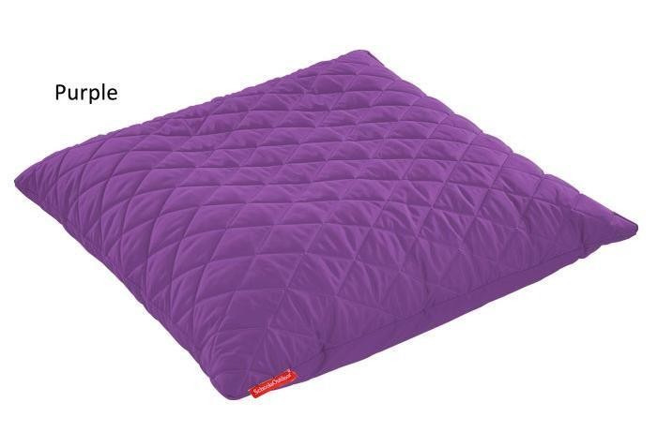
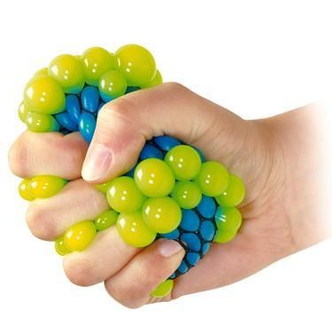

SENSORY TOOLS
Could you have a sensory box at home?

Slide 19
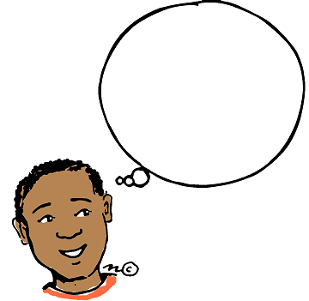
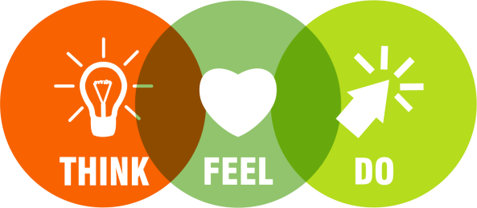

Slide 20
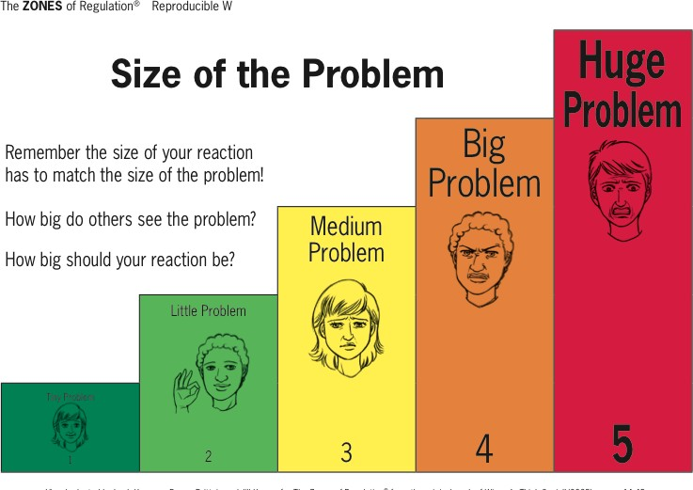
-SIZE OF THE PROBLEM LEARNING STARTS IN YEAR 2.
-YEAR 3 – 6 EXPLORES EXPECTED AND UNEXPECTED
REACTIONS… MAKE SURE YOU FREQUENTLY PRAISE YOUR CHILD FOR HAVING EXPECTED REACTIONS RATHER THAN JUST
POINTING OUT THE UNEXPECTED.

Slide 21
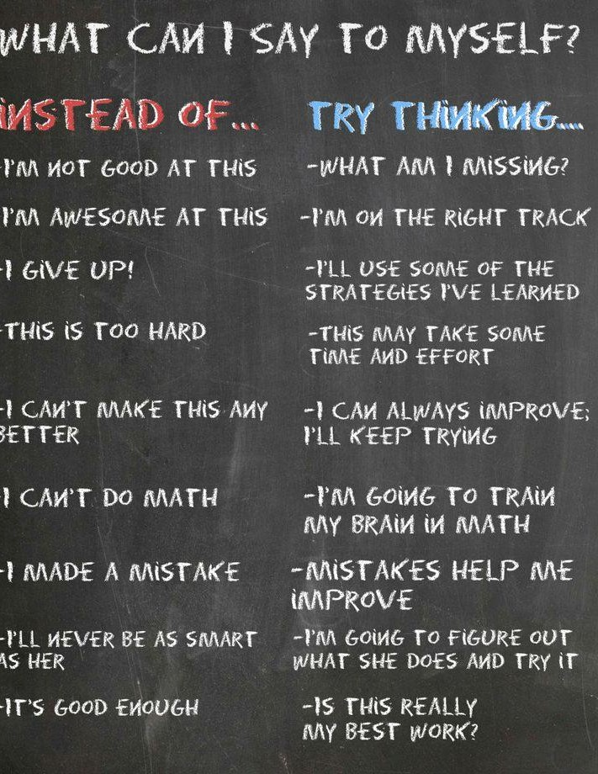
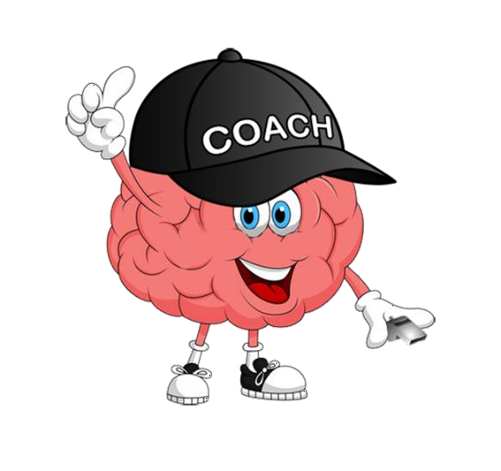
INNER COACH VS
INNER CRITIC

Slide 22
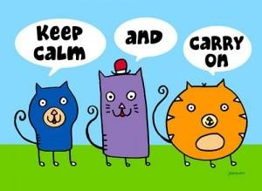
CALMING STRATEGIES

Slide 23
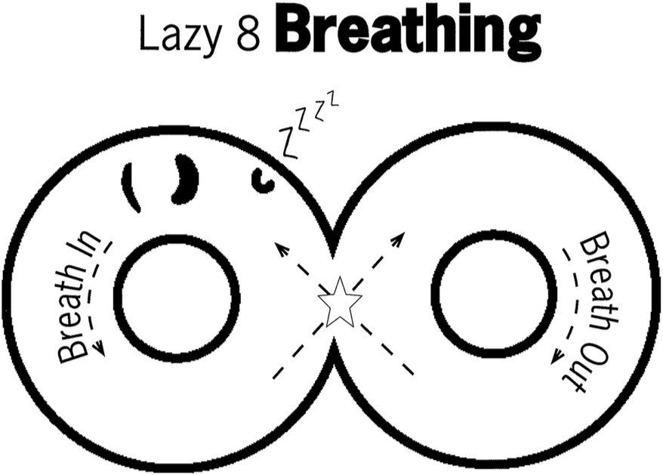
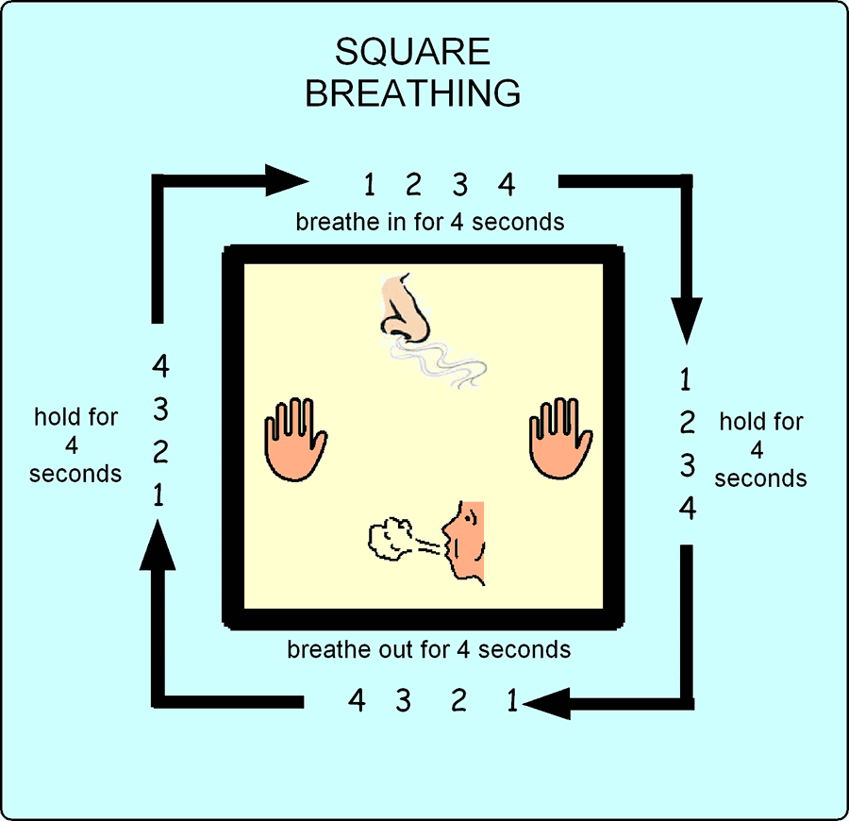
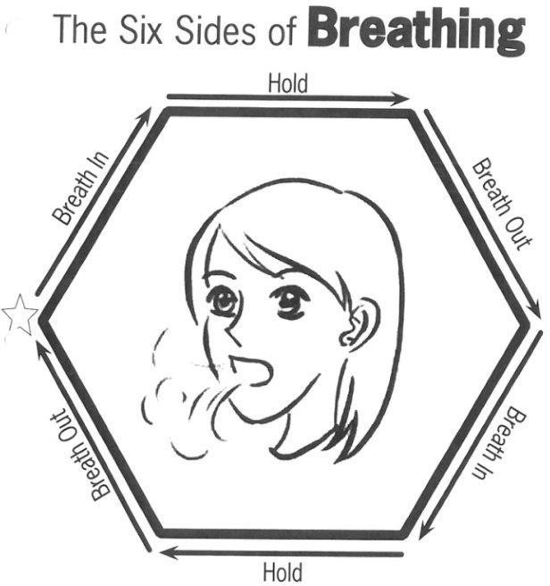
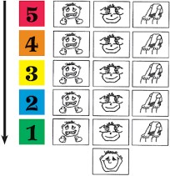

Slide 24


COUNTING
Forward and backward
Count objects
Count colours
Count breaths
Count pulse
Use of Fit bit (relaxation and pulse tracking)

Slide 25




CALMING ACTIVITIES
Puzzles
Listen to Music Draw/Paint Origami
Play-Doh/clay Read
Stack Rocks

Slide 26
HOW CAN I SUPPORT THE ZONES OF REGULATION?
Identify your own feelings using Zones language in front of your child (e.g.“I’m frustrated, I am in the yellow zone”)
Provide positive reinforcement when your child is in the Green Zone and if they make efforts to stay in the Green Zone. Eg. “I can see you are working really hard to stay in the Green Zone by…”
Talk about what tool you will use to be in the appropriate Zone
(e.g.“I’m going to go for a walk, I need to get to the green zone”)
Label what zones your child is in throughout the day (e.g.“You look sleepy, are you in the blue zone?”)
Teach your child which Zones tools they can use (e.g.“It’s time for bed, let’s read a book together in the rocking chair to get to the blue zone.”)
Post and reference the Zones visuals and tools in your home (Zone check in stations and toolboxes for the family!) Make portable Zones cards (see editable document on website).

Slide 27
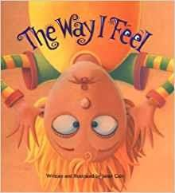
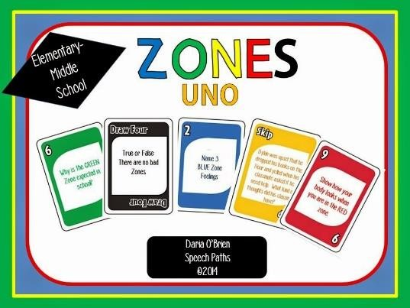
PLAY GAMES
“Feelings Charades”
Take turns choosing emotions from a stack of cards or papers and act
it out using only face and body clues. Guess each other’s emotion,
discuss which zone it’s in and why. (Added challenge: Name a tool you could use when feeling that emotion).
“Name that feeling”
People watch and guess the feelings/zones of others.
Name the feelings of characters while watching a movie (and point out any strategies they use).
Read ‘The Way I Feel’
“Zones Uno” Learn the song!
https://www.youtube.com/watch?v=Vnl3GeTkMa4

Slide 28
MORE INFORMATION ON THE ZONES
Zones of Regulation Website
Zones of Regulation Book and CD on Amazon.com
Don’t forget about Pinterest!

